Slide 1


SentinelShield Advanced Linux Security Hardening & Threat Audit Framework
Course Title: Operating Systems Lab
Course Code: CSE-402
Section: 231-D2
Course Teacher’s Name: Md. Shoaib Alam
12/25/2025
SentinelShield: Advanced Linux Security Hardening & Threat Audit Framework
1

Slide 2

The Threat Audit Team: Expertise Driving Linux Security
Our team combines deep expertise in Linux security and automation. This enables us to design robust and real-world system solutions.
Promod Chandra Das
231002005
Dept of CSE
Green University of Bangladesh
Chinmoy Debnath
231902029
Dept of CSE
Green University of Bangladesh
12/25/2025
SentinelShield: Advanced Linux Security Hardening & Threat Audit Framework
2

Slide 3

Why SentinelShield?
Linux systems are often misconfigured .An automated, policy-based, safe security framework..
Manual security checking is:
Time-consuming
Error-prone
Inconsistent
12/25/2025

Slide 4
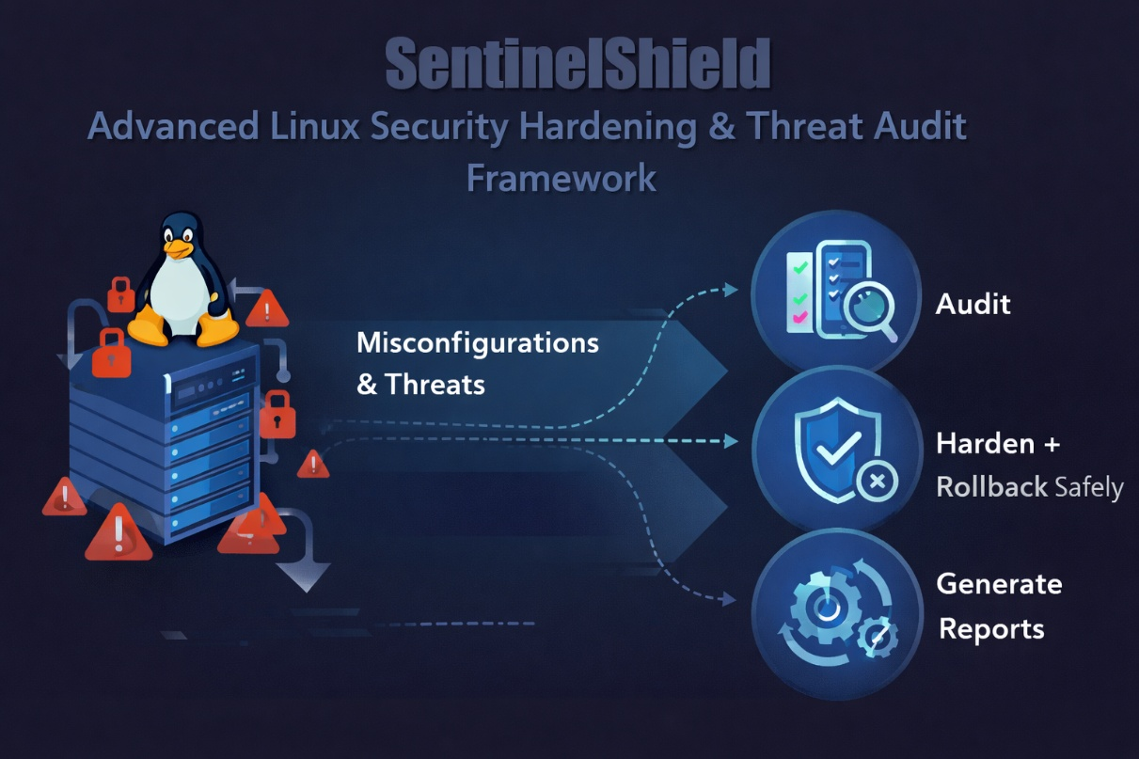
Main Goal?
To design a Bash-based Linux security framework that can:
Audit system security
Validate against security policies
Safely apply SSH hardening
Roll back on failure
Generate security reports with score
12/25/2025

Slide 5
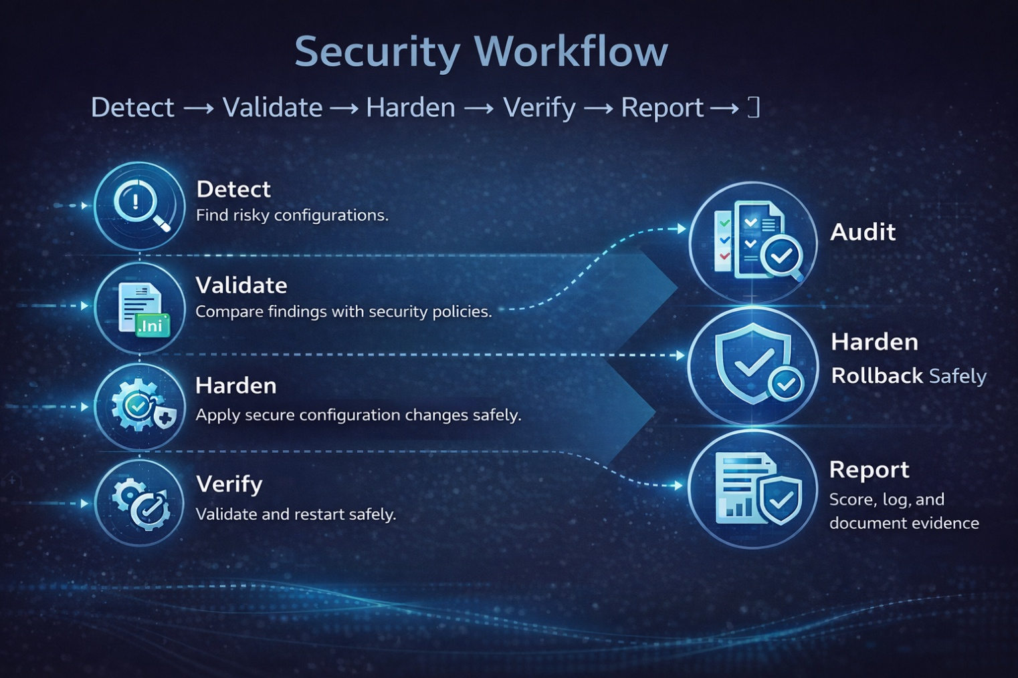
Security Workflow!
Detect → Validate → Harden → Verify → Report
1
Detect
Find risky configurations.
2
Validate
Compare with policy (INI).
3
Harden
Apply secure settings (safe).
Verify
Validate config + restart.
4
5
Report
Score + log + evidence
12/12/2025
5

Slide 6

Technologies Used
Whiptail (menu-driven TUI)
INI configuration file
Bash Script
12/25/2025
6

Slide 7

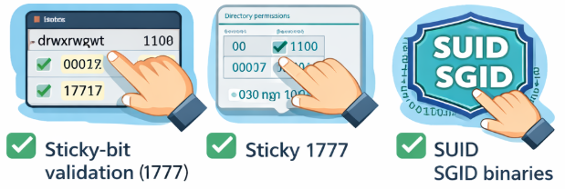
What is audited?
World-writable files & directories
Open / listening ports
Running & enabled services
Sticky-bit validation (1777)
SUID / SGID binaries
12/25/2025
7
SentinelShield: Advanced Linux Security Hardening & Threat Audit Framework

Slide 8
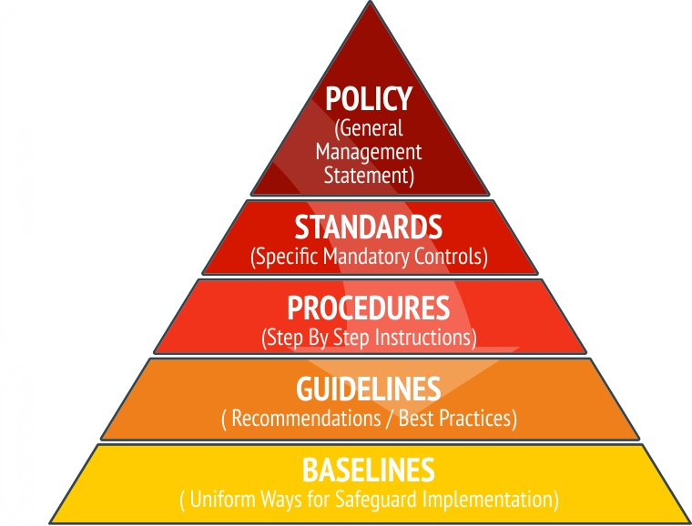
Policy-based Security?
sentinel_policy.ini
Example rules:
PermitRootLogin = no
PasswordAuthentication = no
Rule Logic
Unset configuration = NON-COMPLIANT (FAIL)
Clear PASS / FAIL output
12/25/2025

Slide 9




SSH Hardening (Safe Design)
Hardening Steps.
1:Take backup of sshd_config
2. Apply policy values
3. Validate using sshd –t
4. Restart SSH service
5. Auto-rollback on failure
Key Metric: Active
Users
Key Metric: If SSH is not installed → Hardening = N/A
Key Metric: policy values
12/25/2025
9

Slide 10

Report & Scoring System
Generated Report Includes
Scoring Logic
World-writable issues → score deduction
Policy mismatch → score deduction
SSH not installed → no penalty
System information
Audit results
SSH security status
Open ports & services
Security score (0–100)
12/25/2025
10

Slide 11

CPU Scheduling Module
Algorithms Implemented
Output
Waiting Time (WT)
Turnaround Time (TAT)
Gantt Chart
Average WT & TAT
FCFS
SJF (Non-preemptive)
Round Robin (Quantum)
12/25/2025
11

Slide 12


Conclusion & Future Scope?
Achievements
Future Enhancements
Firewall (UFW) hardening
CIS benchmark checks
HTML / PDF reports
Cron-based scheduled scans
Safe SSH hardening with rollback
Policy-based decision making
User-friendly menu interface
Fully automated Linux security audit
12/25/2025
12

Slide 13


